Slide 1
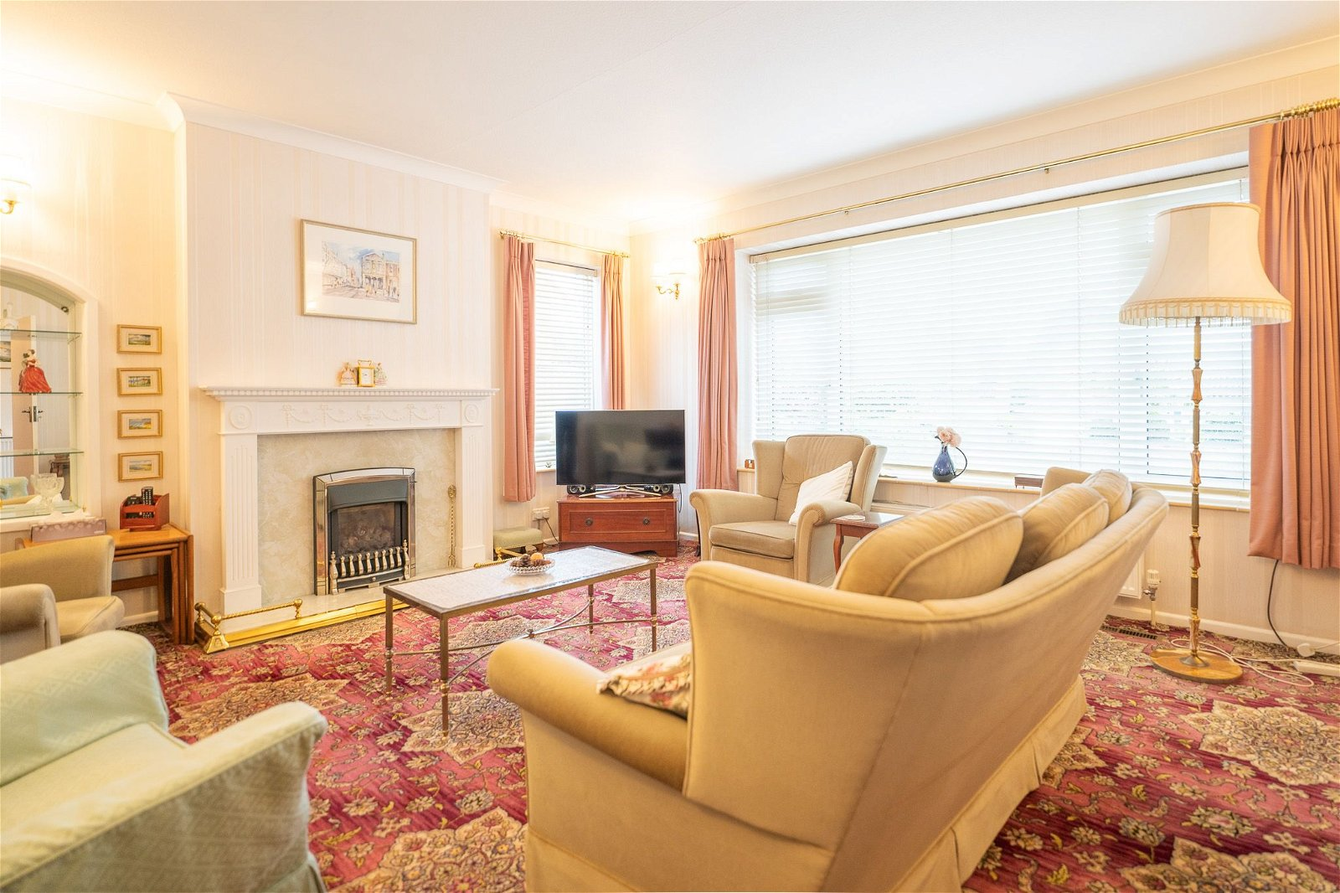
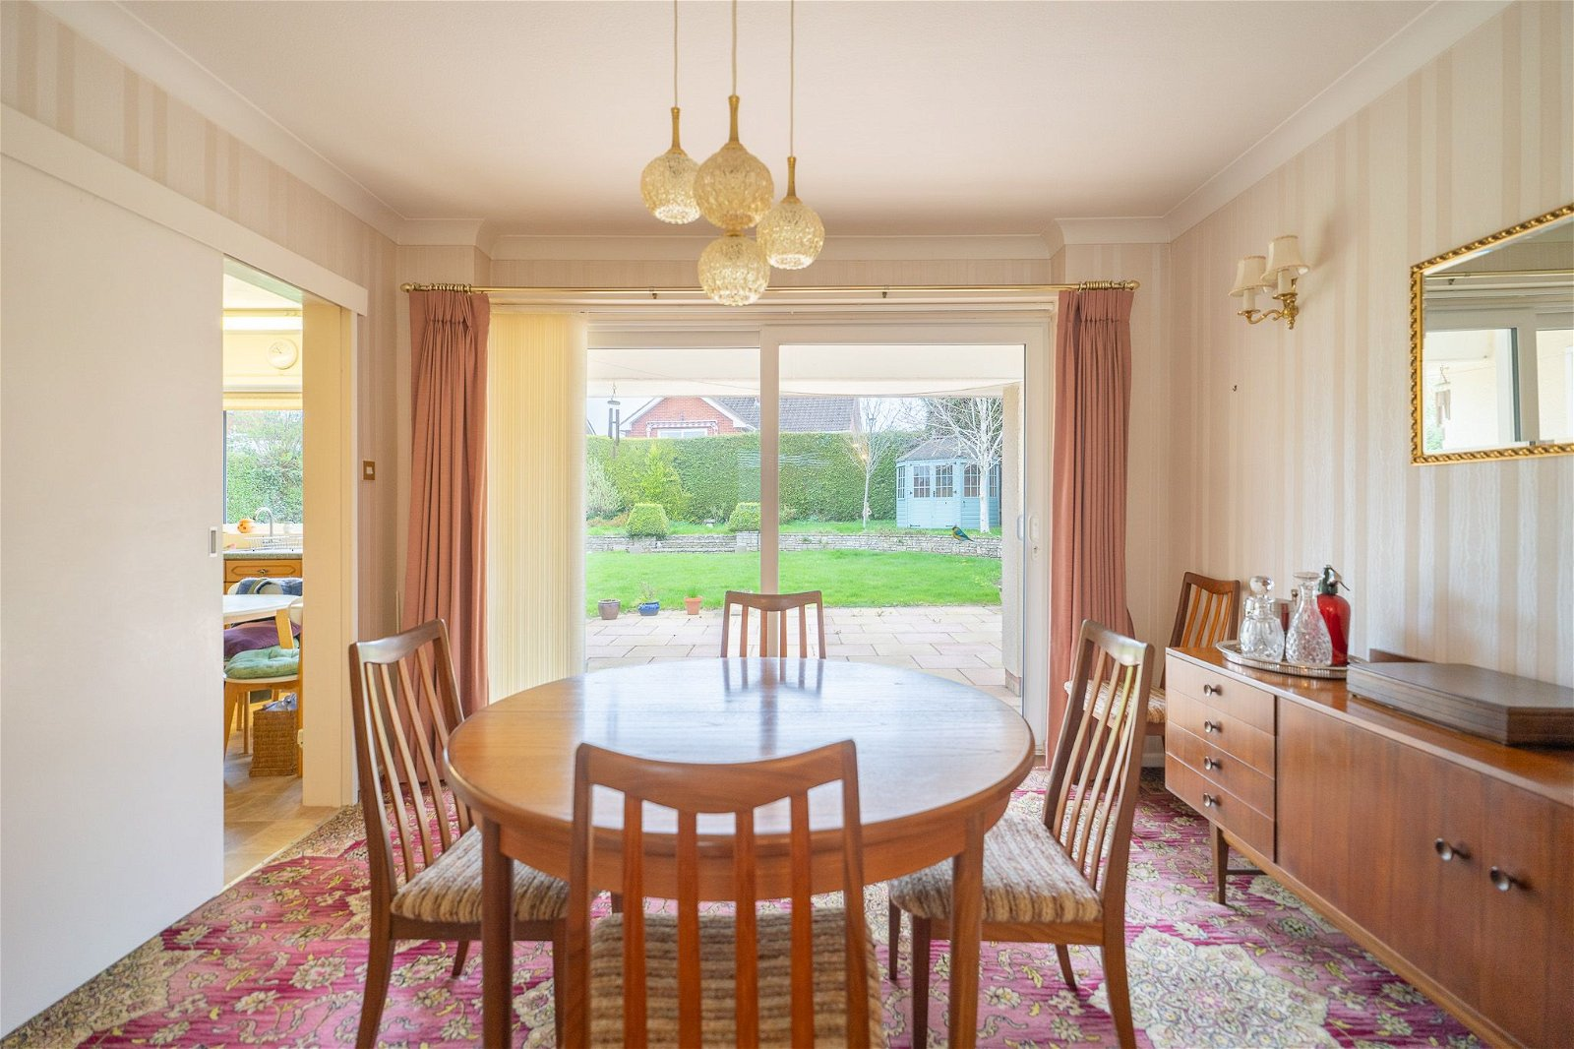
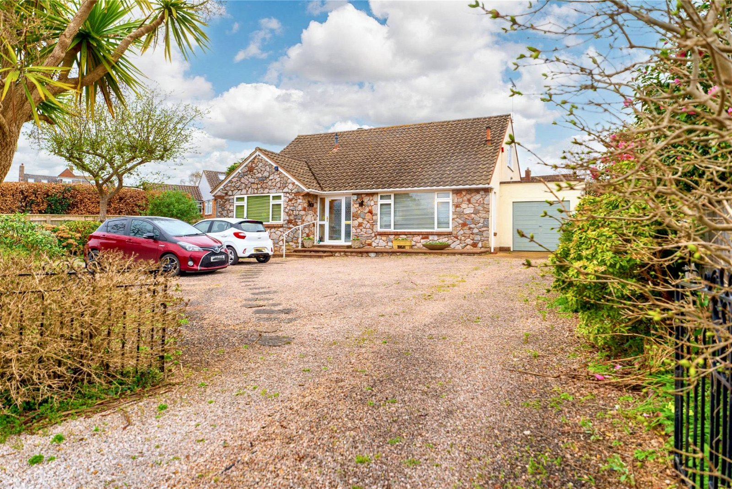
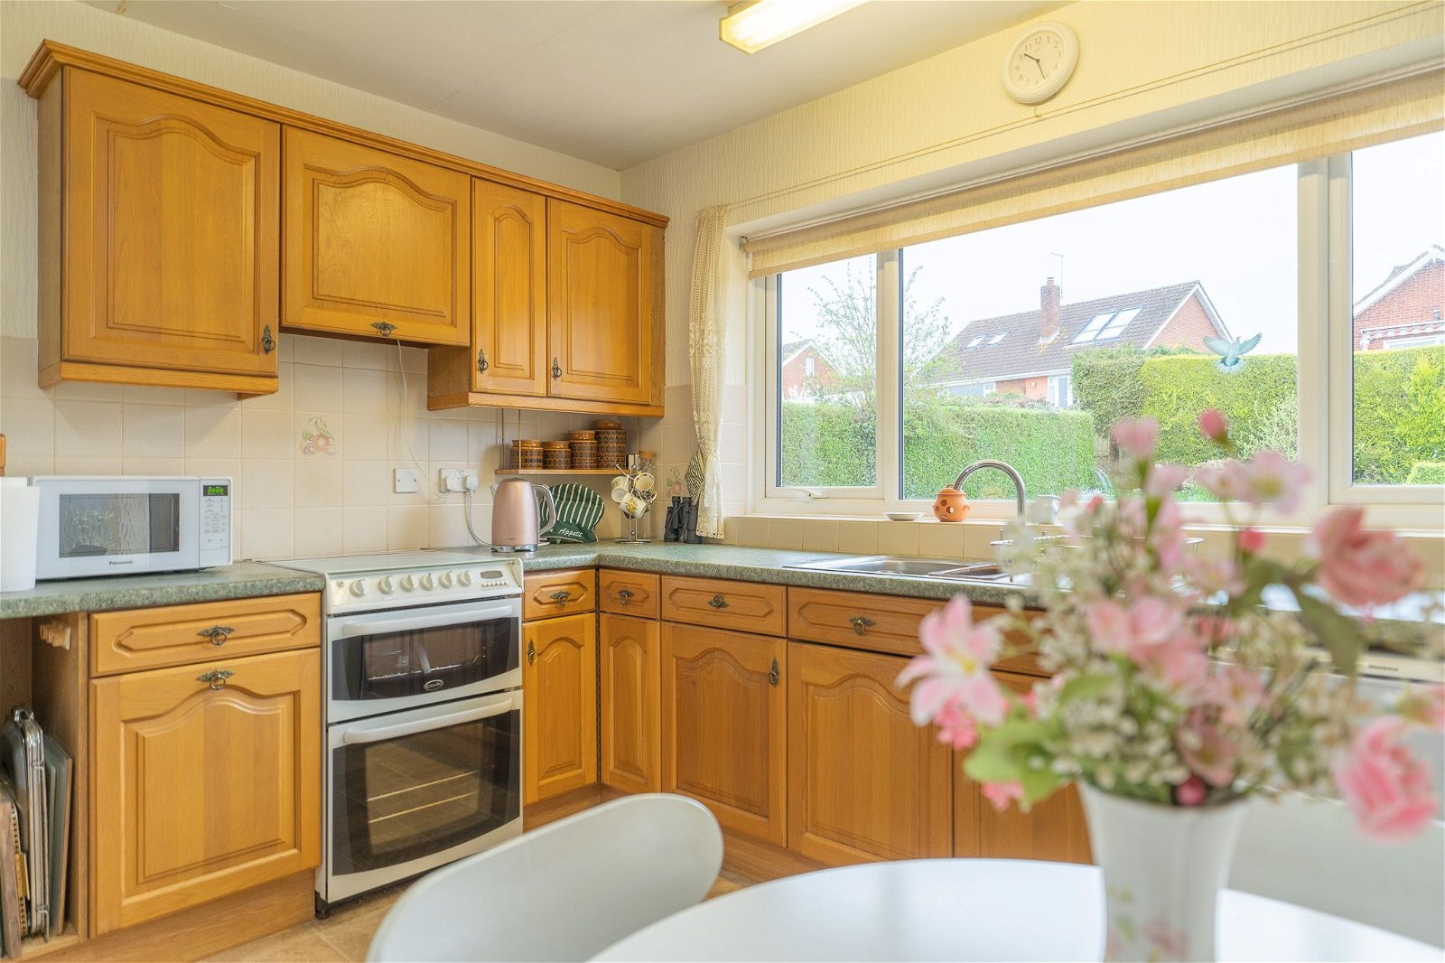
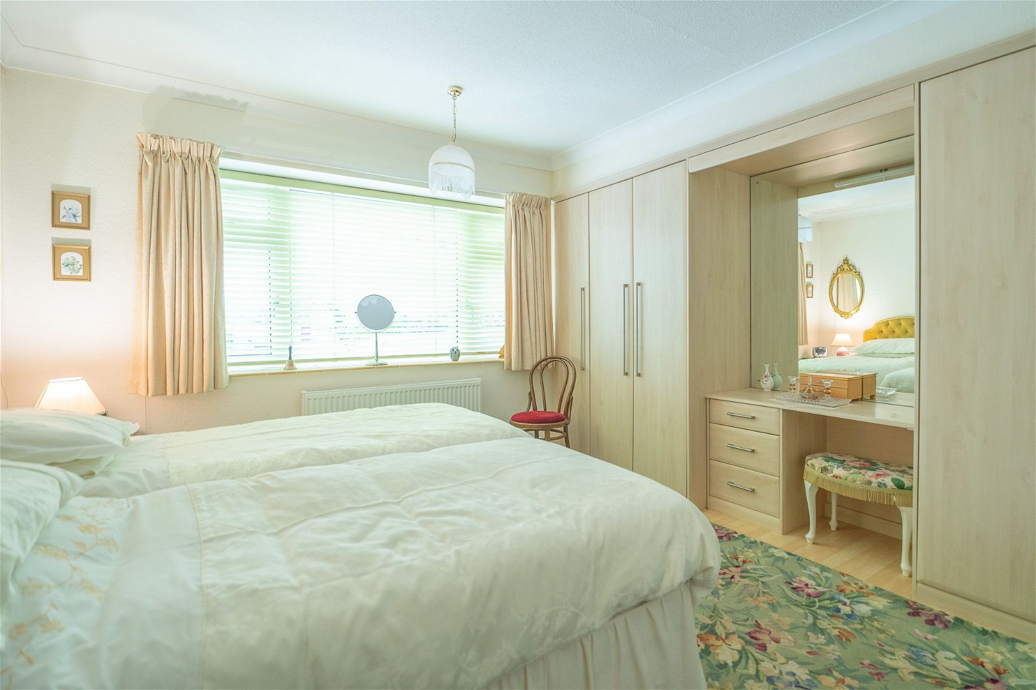
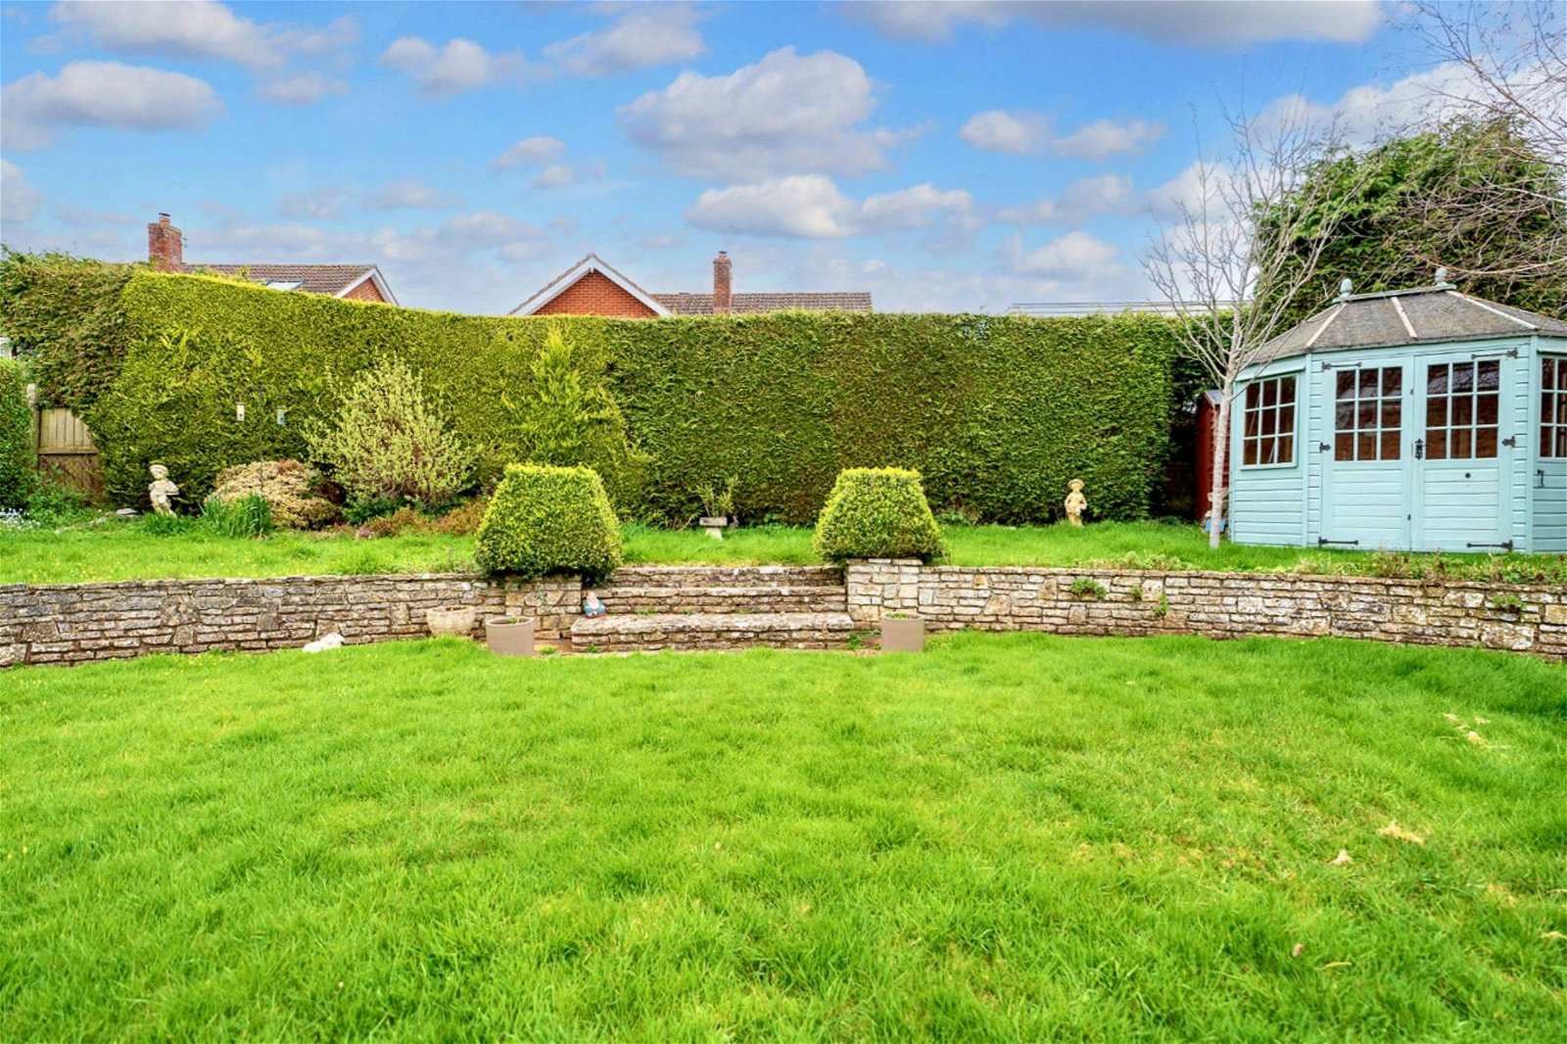
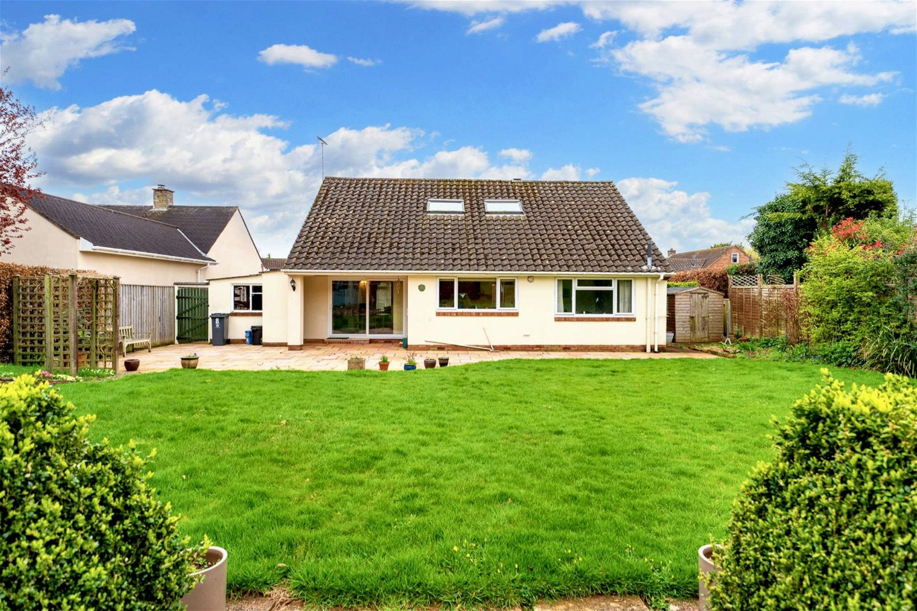
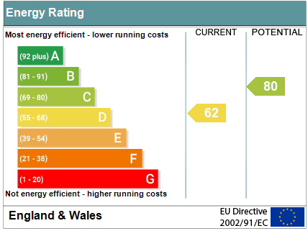
www.pennys.net
8 Cranford Close, Exmouth, EX8 2HR
PRICE £750,000
TENURE Freehold
A Deceptively Spacious Four Bedroom Detached Chalet Style Bungalow Enjoying An Enviable 'Avenues' Location With Generously Sized Gardens, Ample Parking And Garage
Entrance Porch & Spacious Reception Hall • Lounge • Dining Room •
Kitchen/Breakfast Room • Two Ground Floor Double Bedrooms • Ground Floor Bath/Shower Room • Separate WC • Two First Floor Double Bedrooms • First Floor Shower Room/WC • Gas Central Heating • Double Glazed Windows •
No Onward Chain • Viewing Recommended •
Pennys Estate Agents Limited for themselves and for the vendor of this property whose agents they are give notice that:- (1) These particulars do not constitute any part of an offer or a contract. (2) All statements contained in these particulars are made without responsibility on the part of Pennys Estate Agents Limited. (3) None of the statements contained in these particulars are to be relied upon as a statement or representation of fact. (4) Any intending purchaser must satisfy himself/herself by inspection or otherwise as to the correctness of each of the statements contained in these particulars. (5) The vendor does not make or give and neither do Pennys Estate Agents Limited nor any person in their employment has any authority to make or give any representation or warranty whatever in relation to this property.
PENNYS ESTATE AGENTS
2 Rolle House, Rolle Street, Exmouth, Devon, EX8 2SN
Tel: 01395 264111 EMail: help@pennys.net

Slide 2
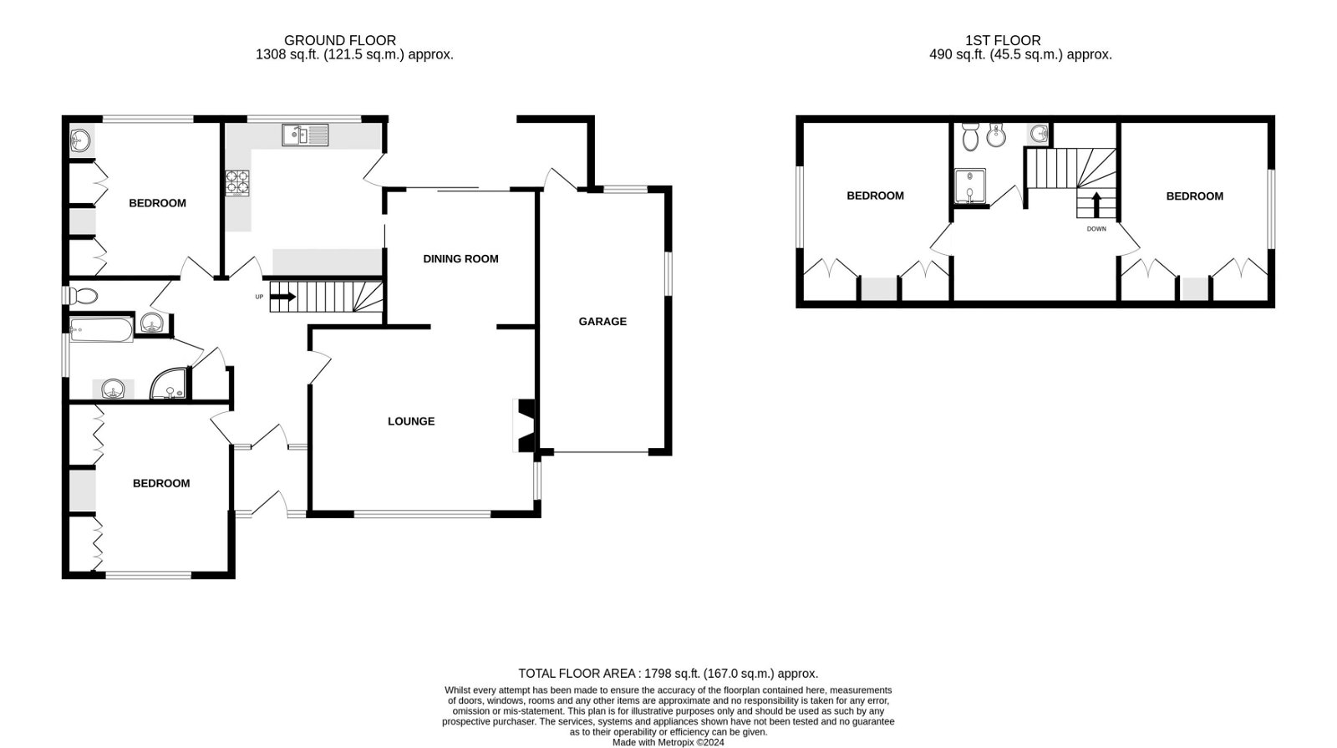
8 Cranford Close, Exmouth, EX8 2HR
THE ACCOMMODATION COMPRISES: Double glazed front door to: ENTRANCE PORCH: Wall lighting; inner glazed door to: SPACIOUS RECEPTION HALL: A fine entrance to the property with staircase rising to first floor landing with understairs cupboard beneath; cupboard housing Worcester gas boiler with light; radiator with shelf over; wall lighting. LOUNGE: 5.16m x 4.32m (16'11" x 14'2") Double glazed windows to front and side aspects; radiator; living flame coal effect gas fire housing in fire surround; television point; feature arched wall recess with glass shelving; opening to: DINING ROOM: 3.61m x 3.51m (11'10" x 11'6") Double glazed sliding doors to rear covered patio sun terrace; radiator with shelf over; ceiling wall lighting. KITCHEN/BREAKFAST ROOM: 3.71m x 3.63m (12'2" x 11'11") (Accessed from Dining Room & Reception Hall) Fitted with a range of pattern worktop surfaces with cupboards, drawer units, plumbing for an automatic washing machine and appliance space beneath with tiled surrounds; plumbing and space for dishwasher; inset one and a quarter bowl sink unit; gas cooker point; wall mounted cupboards; ceiling spotlighting; double glazed window to rear aspect; radiator with shelf over. GROUND FLOOR BEDROOM ONE: 3.94m x 3.76m (12'11" x 12'4") Double glazed window to front aspect; radiator; built-in range of quality wardrobes incorporating dressing table with mirror over and display lighting; wall lighting. GROUND FLOOR BEDROOM TWO: 3.66m x 3.61m (12'0" x 11'10") Double glazed window to rear aspect; radiator; built-in wardrobes incorporating dressing table with mirror over and vanity wash hand basin with mirror over. GROUND FLOOR BATHROOM/SHOWER ROOM: 3.02m x 2.06m (9'11" x 6'9") Bath with shower over; shower curtain and rail; ease of access shower cubicle with splashback walls; vanity wash hand basin with mirror over and mirror fronted medicine cabinets; electric towel rail; radiator; double glazed window with pattern glass. FIRST FLOOR GALLERIED LANDING: Velux window; display area of stairwell recess; access to roof eaves space. BEDROOM THREE: 3.96m x 3.48m (13'0" x 11'5") Double glazed window to side aspect; built-in wardrobes incorporating dressing table; gas convector heater. BEDROOM FOUR: 3.96m x 3.45m (13'0" x 11'4") Double glazed window to side aspect; access to eaves and roof space; two built-in wardrobes; gas convector heater. SHOWER ROOM/WC: 2.59m x 1.96m (8'6" x 6'5") Shower cubicle; vanity wash hand basin; bidet; WC; velux window; electric towel rail; electric wall heater.
OUTSIDE: Located in a quiet cul-de-sac the property is approached via a large decorative stone driveway and parking area ideal for housing numerous cars, boats etc with shrub beds and leading to GARAGE. Patio sun terrace adjoins the front of the property outside lighting. Patio side path and gate gives access to the rear garden. The rear garden is a lovely feature boosting a large patio sun terrace ideal for outside entertaining, lawn area of gardens with flower and shrub beds, summer house, timber shed and outside lighting. Side area of garden with timber shed and gate back round to the front of the property. GARAGE: 5.94m x 3.07m (19'6" x 10'1") Up and over door; power and light connected; two windows and door to rear garden.
FLOOR PLAN:

